Slide 1
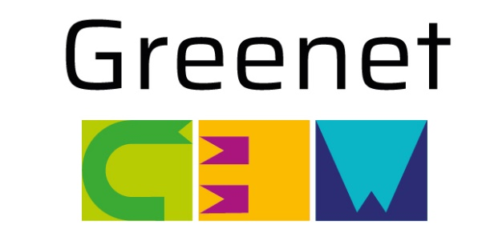

Empowering Horizon Europe applicants through National Contact Points’ tools and services
08/05/2025; 14:00 – 15:30
EXPO XXI WARSAW
Warsaw, Poland
The workshop promoted by GREENET, the European network of National Contact Points for Cluster 5 of Horizon Europe, explores the vital role of National Contact Points (NCPs) in supporting Horizon Europe applicants, highlighting the range of services they offer—from expert guidance to matchmaking opportunities. Discover the innovative virtual tools developed by GREENET to simplify applicants' experience. This workshop is your gateway to unlocking new opportunities.

Slide 2

Empowering Horizon Europe applicants through National Contact Points’ tools and services
08/05/2025; 14:00 – 15:30
EXPO XXI WARSAW
Warsaw, Poland
15’ | Intro on GREENET and the role of National Contact Point | Miriam de Angelis, APRE
15’ | Online tools: toolbox, strategic docs repository, stakeholder directory | Bob Flynn, EI
20’ | Networking support (events and tools) | Juan Francisco Reyes, CDTI
15’ | Support to widening countries | Magdalena Głogowska, NCBR
15’ | collaboration with other relevant stakeholders | Thilo Schoenfeld, MESR
10’ | Q&A & Closing remarks | All
 | End of works

